Slide 1
ENGINEERING MATHEMATICS-I
MAT 1151

Slide 2
Differential equations and applications:
First order differential equations, Basic applications.
Methods of solving first order differential equations
Higher order differential equations: Solution of homogeneous and nonhomogeneous linear equations.
Cauchy and Legendre’s differential equations.
Solution of system of differential equations
References: ‘A short course in differential equations’ by Rainville E.D. and Bedient P.E
‘Advanced Engineering Mathematics’ by Kreyzig E
‘Higher Engineering Mathematics’ by B.S.Grewal

Slide 3
Numerical Methods-I:
Interpolation:
Finite differences and divided differences.
Newton-Gregory and Lagrange’s interpolation formulae.
Newton’s divided difference interpolation formula.
Numerical differentiation.
Numerical integration: Trapezoidal rule, Simpson’s one third rule and Simpson’s three eighth rule.
References: Introductory methods of Numerical analysis’ by Sastry S.S
‘Higher Engineering Mathematics’ by B S Grewal

Slide 4
Numerical Methods-II:
Solution of Algebraic and Transcendental equations:
Bisection method, Method of false position, Iteration method, Newton-Raphson method.
Solution of System of Non-linear equations using Newton-Raphson method.
Numerical solution of ordinary differential equations:
Taylor’s series method, Euler’s method, Modified Euler’s method, Runge-Kutta methods.
References: ‘Introductory methods of Numerical analysis’ by Sastry S.S
‘Higher Engineering Mathematics’ by B S Grewal

Slide 5
Matrix Algebra:
Matrices: Elementary column and row transformations, Inverse of a matrix by elementary row operations, Echelon form and rank of a matrix.
System of linear equations: Consistency, Solution by Gauss elimination, Gauss Jordon, Gauss Jacobi and Gauss Seidel methods.
Eigen values and Eigen vectors: Elementary properties, Computation of largest eigen value by power method.
References: ‘Higher Engineering Mathematics’ by B.S.Grewal
‘Introductory methods of Numerical analysis’ by Sastry S S
‘Advanced Engineering Mathematics’ by Kreyzig E

Slide 6
Linear Algebra:
Generalization of vector concept to higher dimensions, Generalized vector operations, Vector spaces and sub spaces, Linear independence and dependence, Basis.
Gram- Schmidt process of orthogonalization.
References: ‘Linear Algebra’ by G. Hadley

Slide 7

LIST OF FORMLAE
TRIGONOMERTY:
Fundamental Identities :
(i) cos² θ + sin² θ = 1
(ii) 1 + tan² θ = sec² θ
(iii) cot² θ + 1 = cosec² θ
Addition and Subtraction formulae:
$sin⁡(x±y) = sin⁡x. cos⁡y±cos⁡x. sin⁡y$
$cos\left(x± y\right)=cosx. cosy∓sinx.siny$
$tan⁡ (x±y) =\frac{tanx±tany}{1∓tanx.tany}$

Slide 8
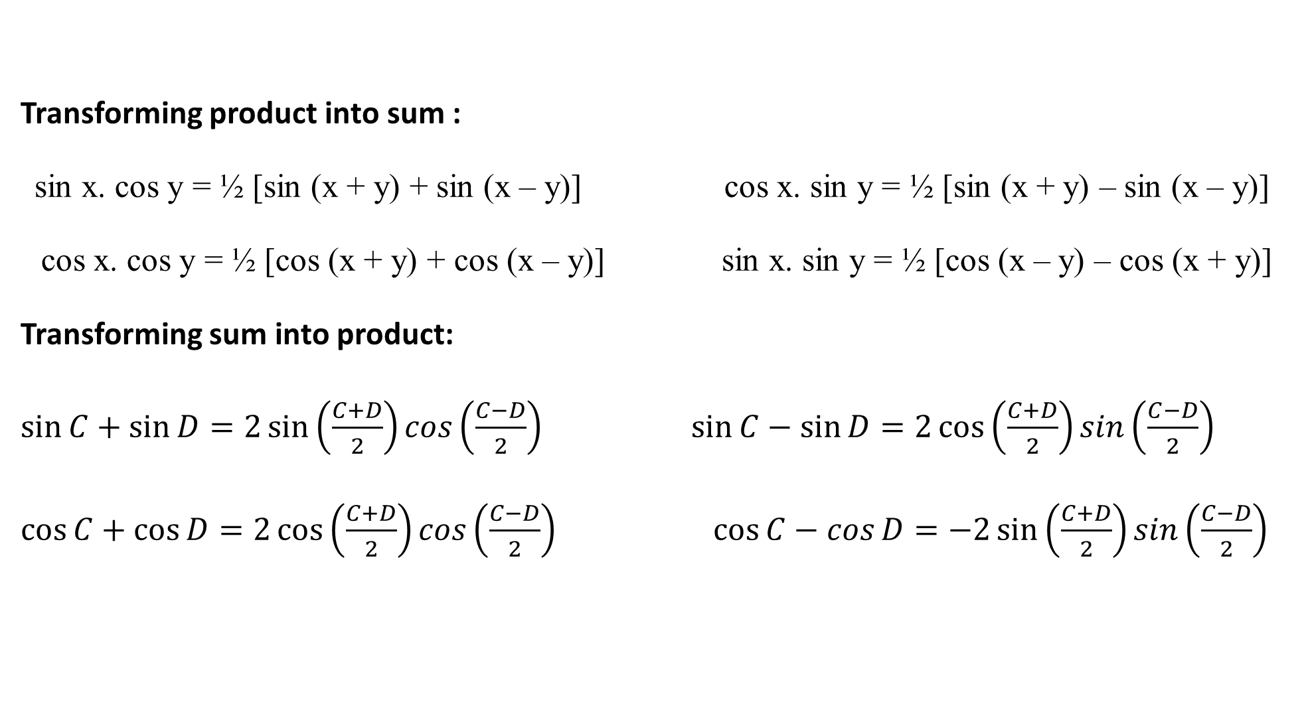
Transforming product into sum :
sin x. cos y = ½ [sin (x + y) + sin (x – y)] cos x. sin y = ½ [sin (x + y) – sin (x – y)]
cos x. cos y = ½ [cos (x + y) + cos (x – y)] sin x. sin y = ½ [cos (x – y) – cos (x + y)]
Transforming sum into product:
$\sin{C+\sin{D}=2\sin\left(\frac{C+D}{2}\right)cos\left(\frac{C−D}{2}\right)}$ $\sin{C−\sin{D}=2\cos\left(\frac{C+D}{2}\right)sin\left(\frac{C−D}{2}\right)}$
$\cos{C+\cos{D}=2\cos\left(\frac{C+D}{2}\right)cos\left(\frac{C−D}{2}\right)}$ $\cos{C−\cos{D}=−2\sin\left(\frac{C+D}{2}\right)sin\left(\frac{C−D}{2}\right)}$

Slide 9

Formulae for multiple angles:
$\sin{2A}= 2\sin{A}\cos{A}=\frac{2tanA}{1+\tan^{2}{A}}$
$cos2A=\cos^{2}{A−\sin^{2}{A}}=1−2\sin^{2}{A=2\cos^{2}{A−1=\frac{1−\tan^{2}{A}}{1+\tan^{2}{A}}}}$
$\tan{2A=\frac{2\tan{A}}{1−\tan^{2}{A}}}$
$\sin{3A}=3\sin{A}−4\sin^{3}{A}$
$\cos{3A}=4\cos^{3}{A}−3cos{A}$
$tan3A=\frac{3tanA−\tan^{3}{A}}{1−3\tan^{2}{A}}$

Slide 10

Differential Calculus:
Rules of differentiation:
$\frac{d}{dx}\left(uv\right)=u\frac{dv}{dx}+v\frac{du}{dx}$ (Product Rule)
$\frac{d}{dx}\left(\frac{u}{v}\right)=\frac{v \frac{du}{dx}−u \frac{dv}{dx}}{v^{2}}$ (Quotient Rule)
$If u = f (z) and z = g (x), then \frac{du}{dx}=\frac{du}{dz}.\frac{dz}{dx}$ (Chain Rule)

Slide 11





$$\frac{d}{dx}\left(cosx \right)=−sinx$$
$\frac{d}{dx}\left(x^{n}\right)=nx^{n−1}$
$\frac{d}{dx}\left(e^{x}\right)=e^{x}$
$\frac{d}{dx}\left(a^{x}\right)=a^{x}log_{e}a$
$\frac{d}{dx}(\log_{e}{x)=\frac{1}{x}}$
$\frac{d}{dx}\left(\sin{x}\right)=cosx$ $\frac{d}{dx}\left(\operatorname{cosec}{x}\right)=−cosecx cotx$
$$\frac{d}{dx}\left(\tan{x}\right)=\sec^{2}{x}$$
$$\frac{d}{dx}\left(\sec{x}\right)=secx tanx$$
$$\frac{d}{dx}\left(\cot{x}\right)=−cosec^{2}x$$

Slide 12

$\frac{d}{dx}\left(\sin^{−1}{x}\right)=\frac{1}{\sqrt{1−x^{2} }}$ $\frac{d}{dx}\left(\cos^{−1}{x}\right)=−\frac{1}{\sqrt{1−x^{2} }}$
$\frac{d}{dx}\left(\tan^{−1}{x}\right)=\frac{1}{1+x^{2}}$ $\frac{d}{dx}\left(\cot^{−1}{x}\right)=−\frac{1}{1+x^{2}}$
$\frac{d}{dx}\left(\sec^{−1}{x}\right)=\frac{1}{x\sqrt{x^{2}−1 }}$ $\frac{d}{dx}\left({cosec}^{−1}{x}\right)=−\frac{1}{x\sqrt{x^{2}−1 }}$

Slide 13
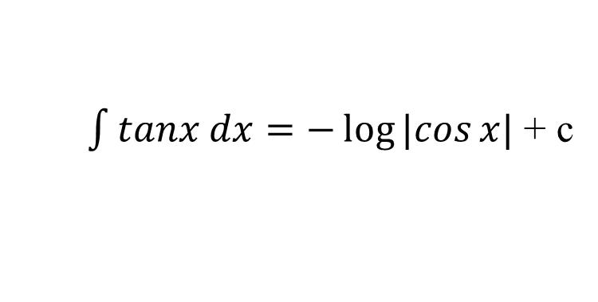
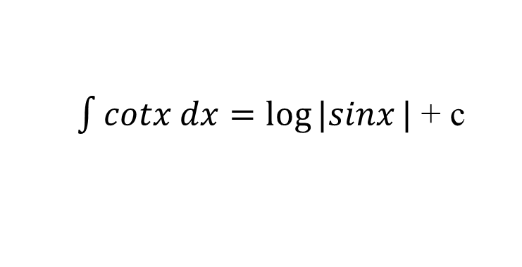
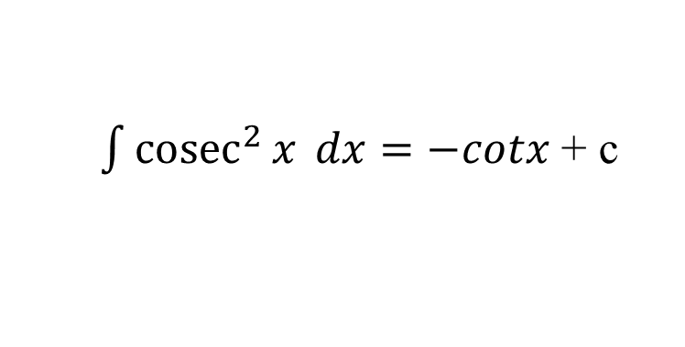

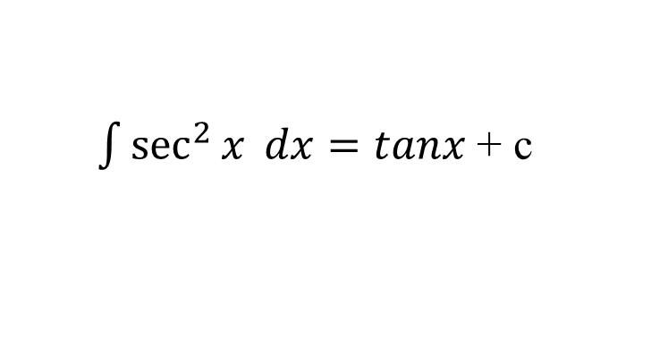
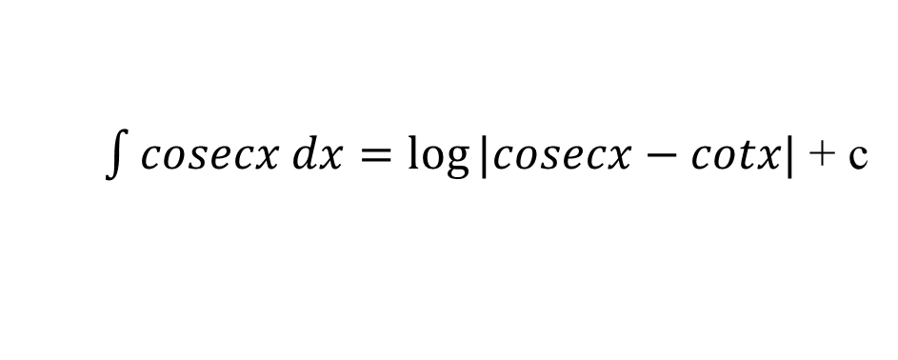
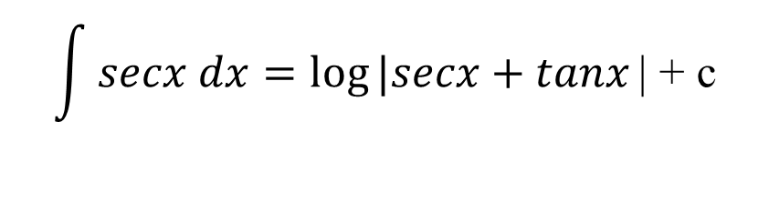
Integral Calculus:
$\int{x^{n}dx=\frac{x^{n+1}}{n+1} (n≠−1)}$ + c
$\int{\frac{1}{x}dx=\log_{e}{x}}$ + c
$\int{e^{x}dx=e^{x}}$ + c
$\int{a^{x}dx=\frac{a^{x}}{\log_{e}{a}} }$ + c
$\int{sinx dx=−cosx}$ + c
$\int{cosx dx=sinx}$ + c
$\int{tanx dx=−\log{|cos}x|}$ + c
$\int{cotx dx=log⁡|sinx}|$ + c
$$\int{secx dx=log⁡|secx+tanx}\text{|}\text{ + }\text{c}$$
$\int{cosecx dx=log⁡|cosecx−cotx|}$ + c
$\int{\sec^{2}{x} dx=tanx}$ + c
$\int{{cosec}^{2}{x} dx=−cotx}$ + c

Slide 14
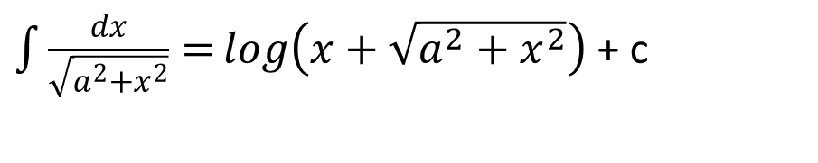

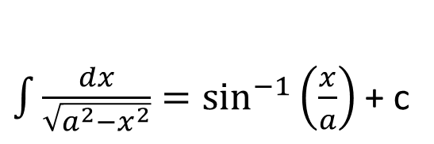
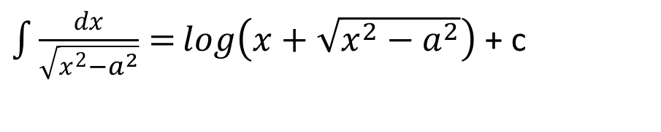
$\int{\frac{dx}{a^{2}+x^{2}}=\frac{1}{a}\tan^{−1}\left(\frac{x}{a}\right){ }}$+ c
$\int{\frac{dx}{a^{2}−x^{2}}=\frac{1}{2a}\log{|\frac{a+x}{a−x}|}}$ + c
$\int{\frac{dx}{x^{2}−a^{2}}=\frac{1}{2a}\log{|\frac{x−a}{x+a}|}}$ + c
$\int{\frac{dx}{\sqrt{a^{2}−x^{2}}}=\sin^{−1}\left(\frac{x}{a}\right) }$+ c
$\int{\frac{dx}{\sqrt{a^{2}+x^{2}}}=}log\left(x+\sqrt{a^{2}+x^{2}}\right)$ + c
$\int{\frac{dx}{\sqrt{x^{2}−a^{2}}}=}log\left(x+\sqrt{x^{2}−a^{2}}\right)$ + c

Slide 15

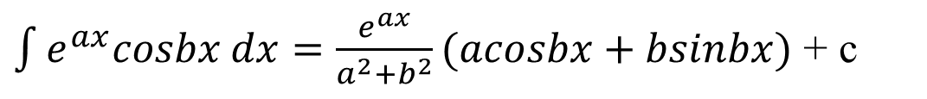
$\int{\sqrt{a^{2}+x^{2}}}dx=\frac{x}{2}\sqrt{a^{2}+x^{2}}$ + $\frac{a^{2}}{2}log\left(x+\sqrt{a^{2}+x^{2}}\right)$ + c
$\int{\sqrt{x^{2}−a^{2}}}dx=\frac{x}{2}\sqrt{x^{2}−a^{2}}$ - $\frac{a^{2}}{2}log\left(x+\sqrt{x^{2}−a^{2}}\right)$ + c
$$\int{\sqrt{a^{2}−x^{2}}dx=\frac{x}{2}\sqrt{a^{2}−x^{2}}+\frac{a^{2}}{2}\sin^{−1}\left(\frac{x}{a}\right) +c}$$
$\int{e^{ax}sinbx dx=\frac{e^{ax}}{a^{2}+b^{2}}(asinbx−bcosbx)}$ + c
$\int{e^{ax}cosbx dx=\frac{e^{ax}}{a^{2}+b^{2}}(acosbx+bsinbx)}$ + c

Slide 16
Thank You!!

